Slide 1
CONTRIBUTORY PENSION SCHEME – CLEARANCE OF MISSING CREDITS
OVERVIEW OF EXISTING SYSTEM
In Earlier The Cps schedule details entered manually by the A.G's Office.
After Taken over by GDC, the Text File system has been introduced and it has been implemented
statewide.
In the system, the error records are removed and It is uploaded as Part Want and Full want in online. All the online entries has been entered by DDO/TO/PAO and processed by GDC.
The existing system has some disadvantage of removing the error records and the user in Treasury Level has to input Lot of details and user doesn’t know the errors occurred. To overcome this error, a new text uploading system has been tested.

Slide 2
CONTRIBUTORY PENSION SCHEME – CLEARANCE OF MISSING CREDITS
OVERVIEW OF NEW SYSTEM
A new system has been created and tested to clear the schedule missing credits in treasury level, all the errors are short listed in four categories namely
1)Upload Error
2)Name Mismatch
3)Excess Payment
4)Ref Date Error
The above errors are identified and updated the correct data in this system.
2) A new system has been created and tested to clear the challan missing credits both in DDO level and in treasury level and named as ONLINE CPS CHALLAN GENERATION FORM. This process reduces the lot of data feeding work in Treasury level. In the existing system some of the DDOs are remitting the CPS challan without schedule details. But this system not allows to generate and remit the challan without individual details.

Slide 3
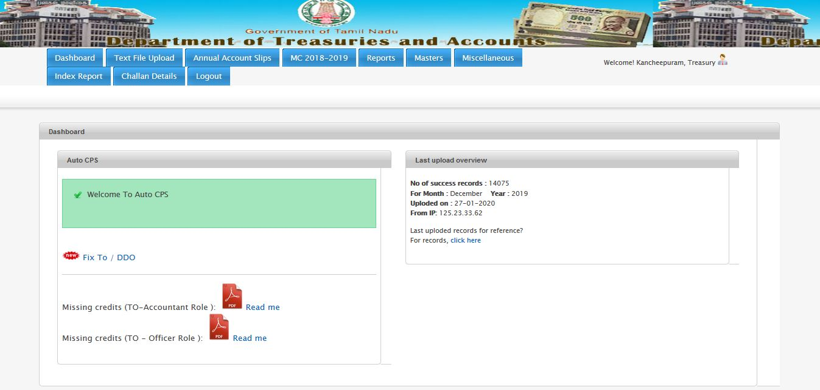
TREASURY/PAO ADMIN LOGIN

Slide 4
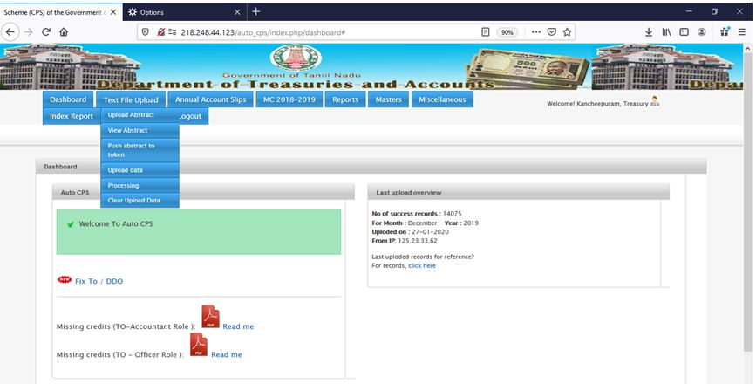
STEP 1:UPLOAD ABSTRACT
(Upload the EXCEL FILE already downloaded from GDC LOGIN)
Downloading procedure from GDC login is as follows in the upcoming pages.
URL : http://treasuty2.tn.gov.in/reports.aspx

Slide 5
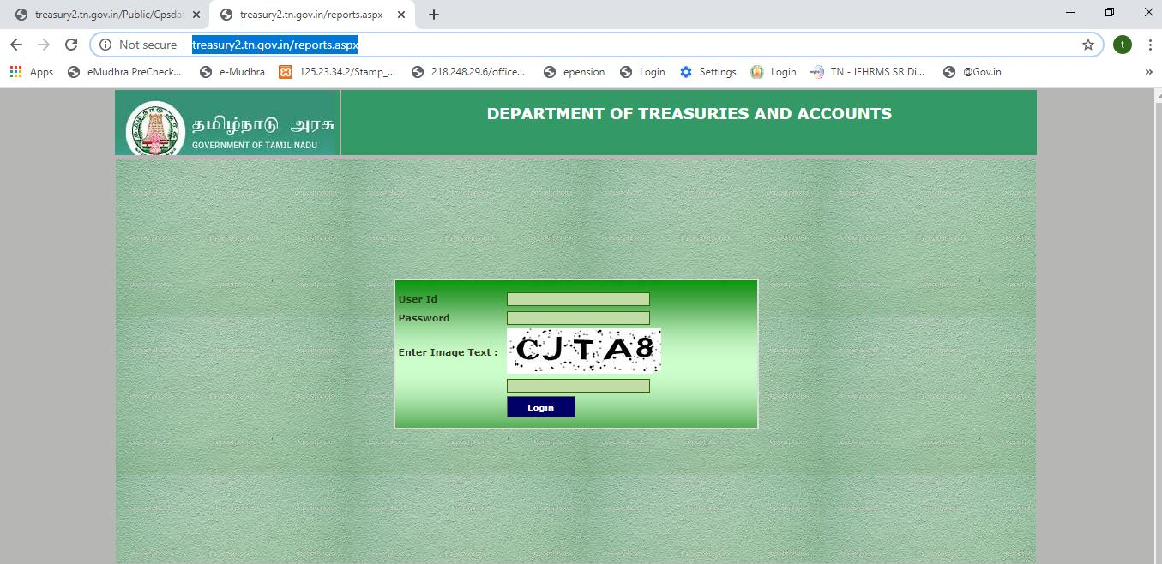
Excel file downloading url

Slide 6
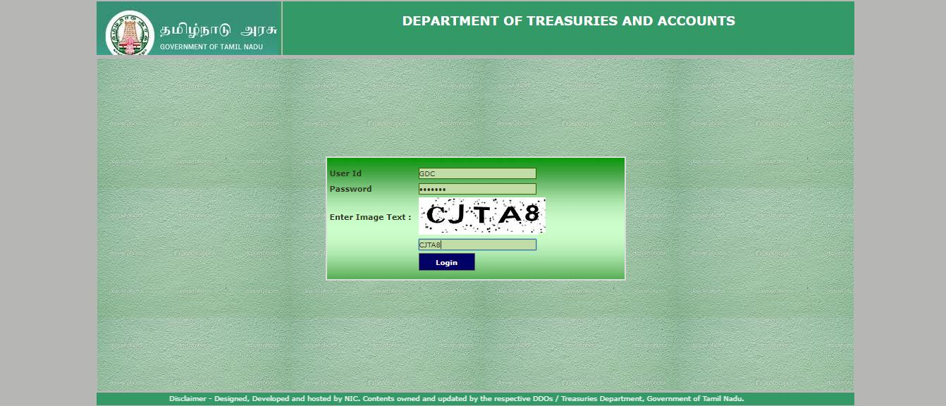
User ID:GDC
Password:gdc_123

Slide 7
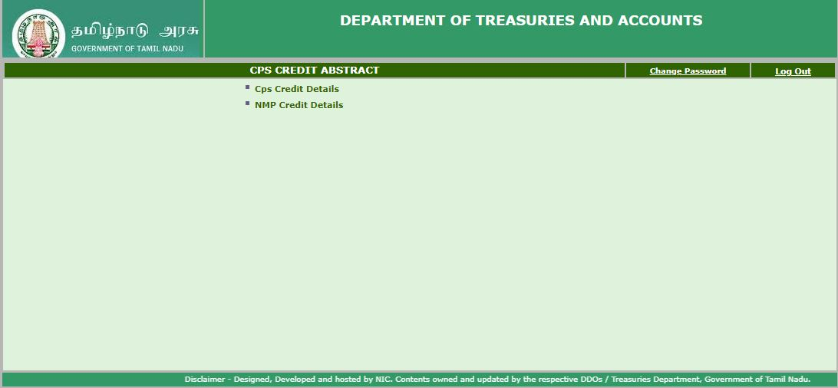
Click the CPS Credit Details

Slide 8
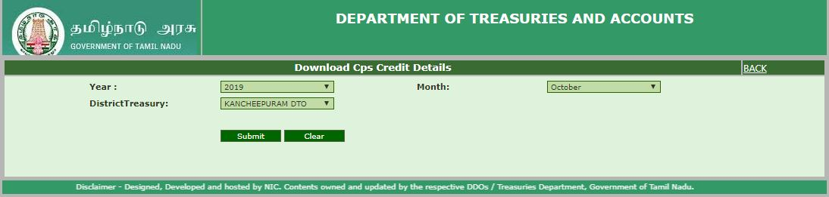
Mention ( Year ,Month , District/PAO) and SUBMIT

Slide 9
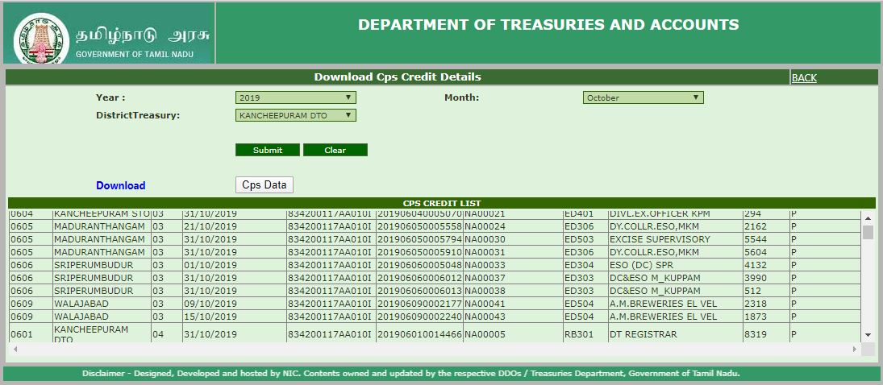
Click the CPS data and Download the file

Slide 10
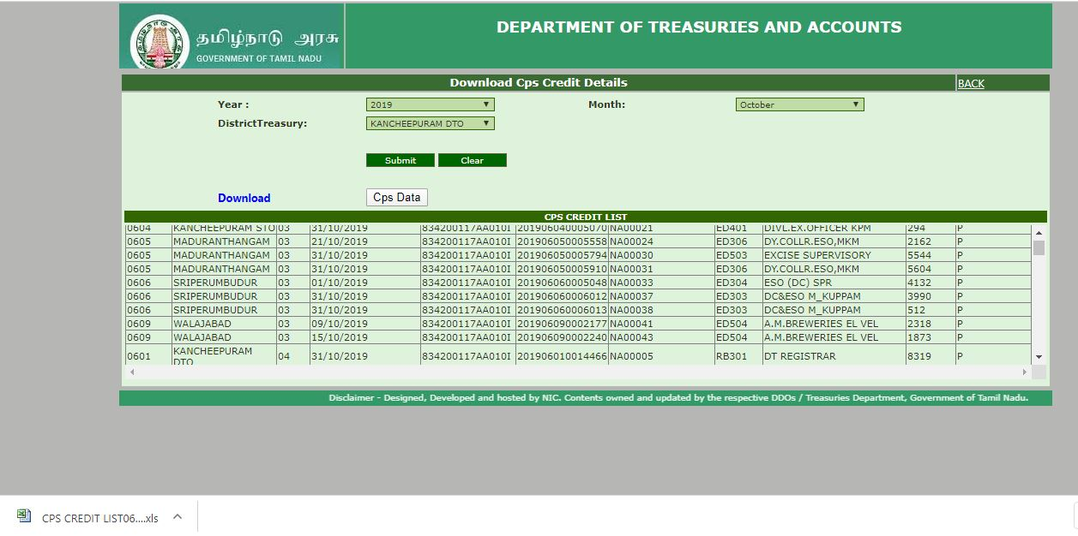
Cps excel file downloaded

Slide 11
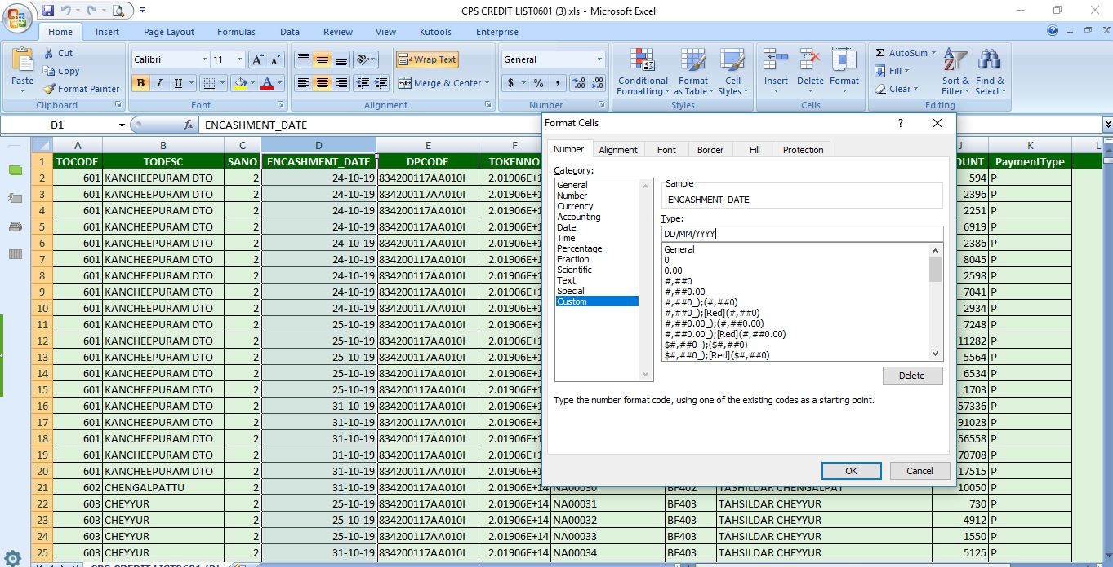
Encashment date : Change the date format for the below method(DD/MM/YYYY)

Slide 12
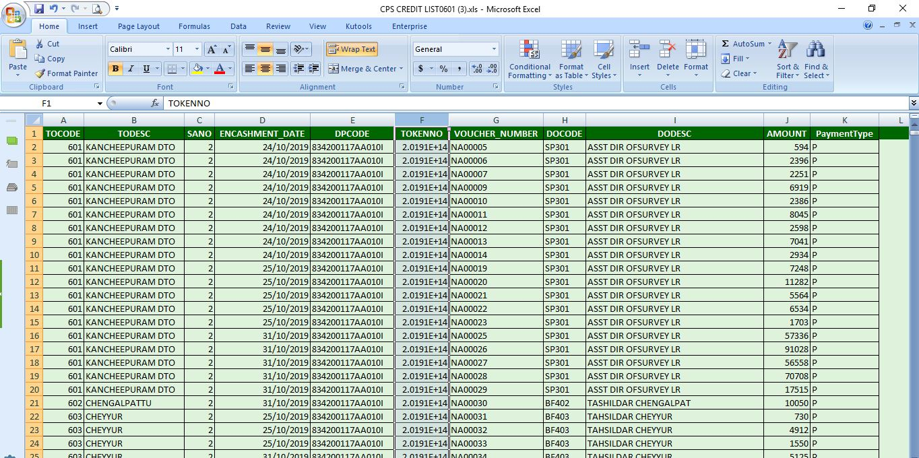

Slide 13
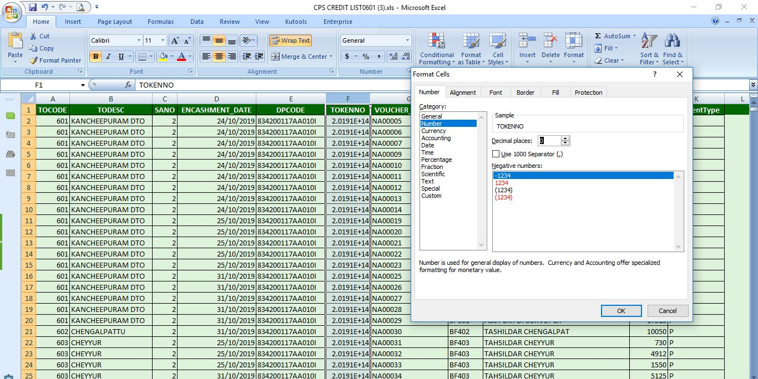
TOKENNO COLUMN RIGHT CLICK ->FORMAT CELLS -> NUMBER->Decimal Places-’0’->ok

Slide 15
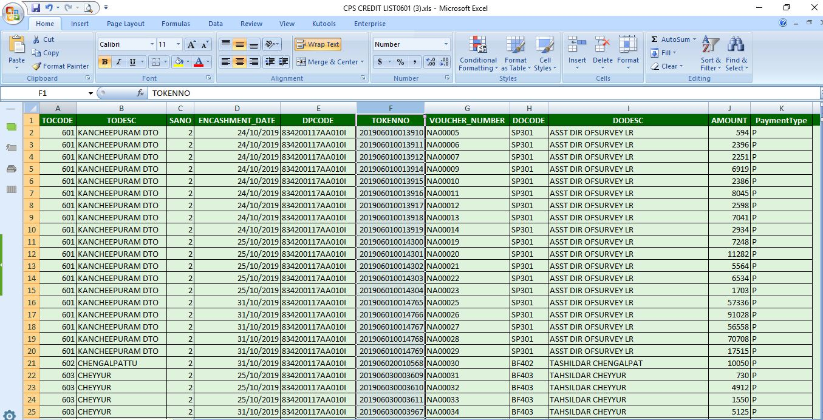
Saves as file type: cps oct 2019.xlsx

Slide 16
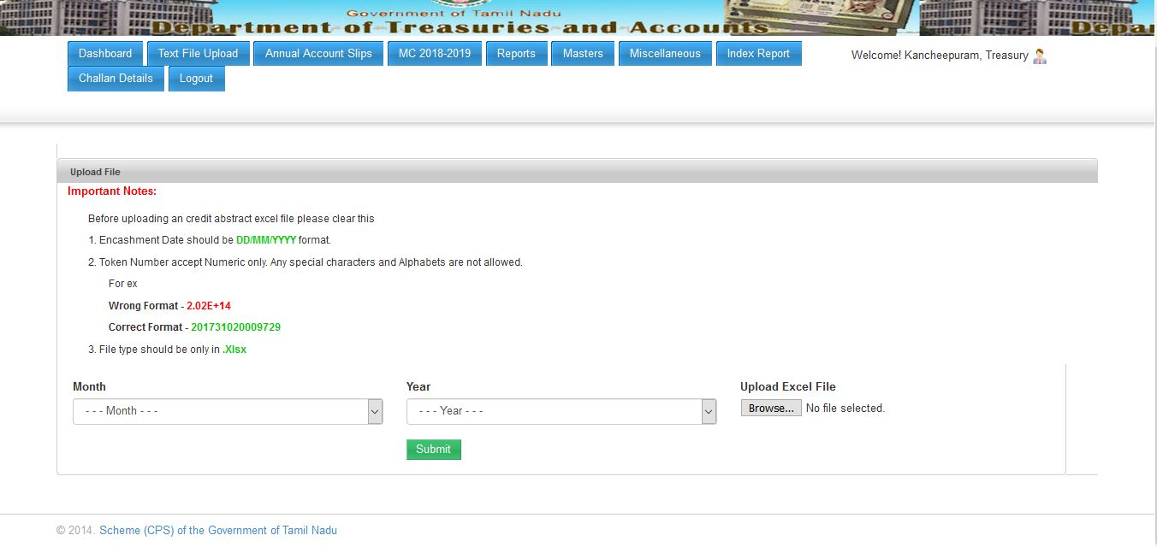
Cps oct 2019 abstract data(excel) successfully completed as per procedures.

Slide 17
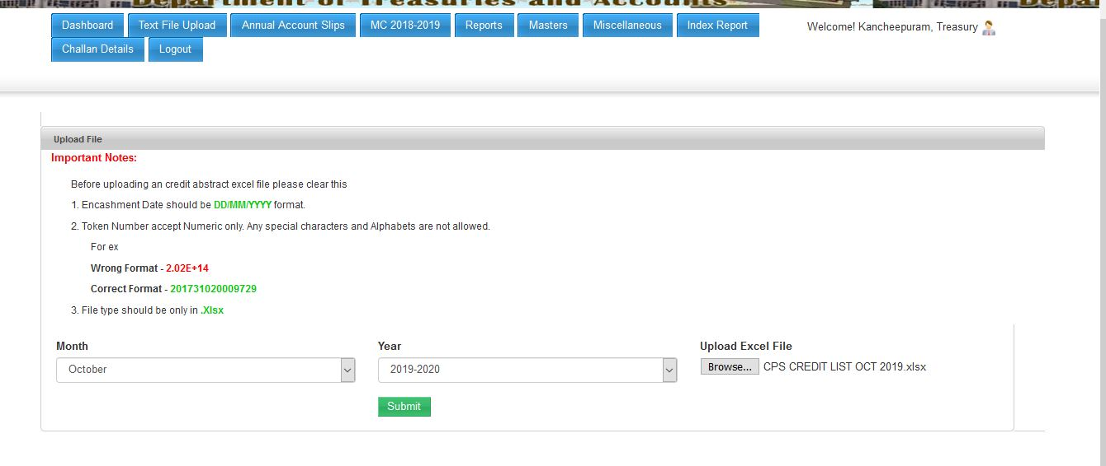
Select Month, Year ,Browser(cps oct 2019.xlsx) and Submit

Slide 18
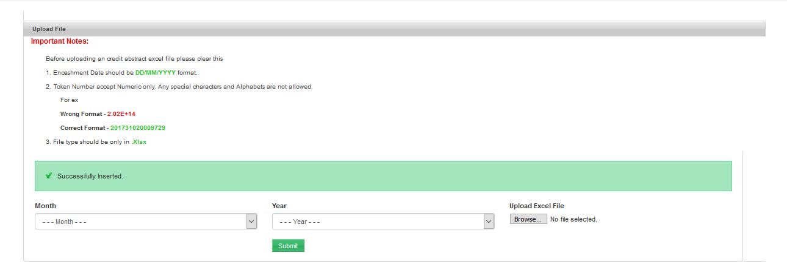
Successfully inserted

Slide 19
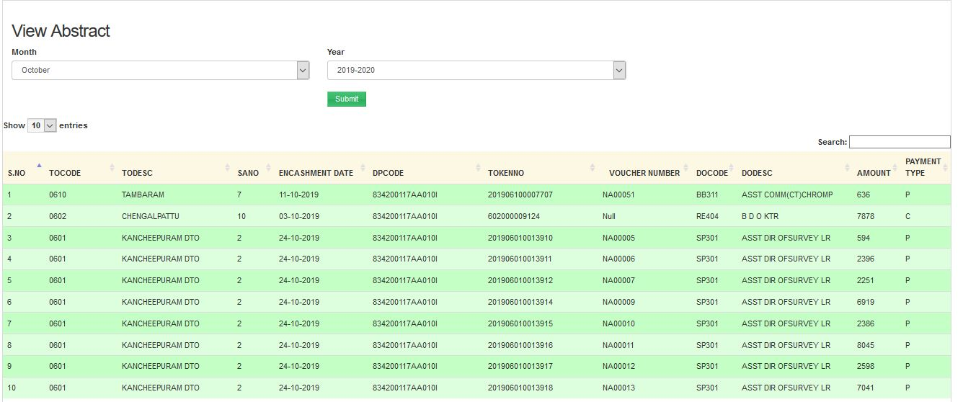
View Abstract: Text File upload->View Abstract(.xlsx file uploaded data only showing)

Slide 20
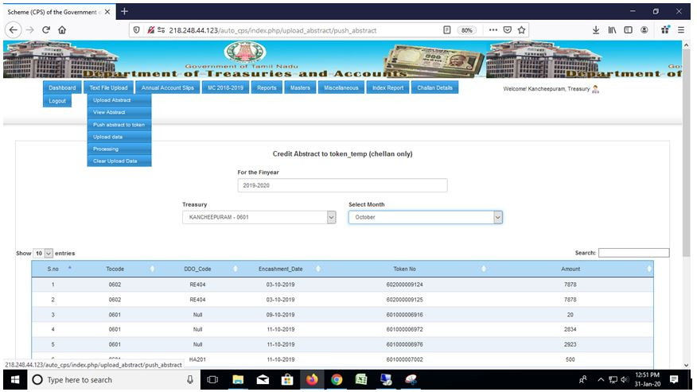
Step 2: Push abstract to token

Slide 21
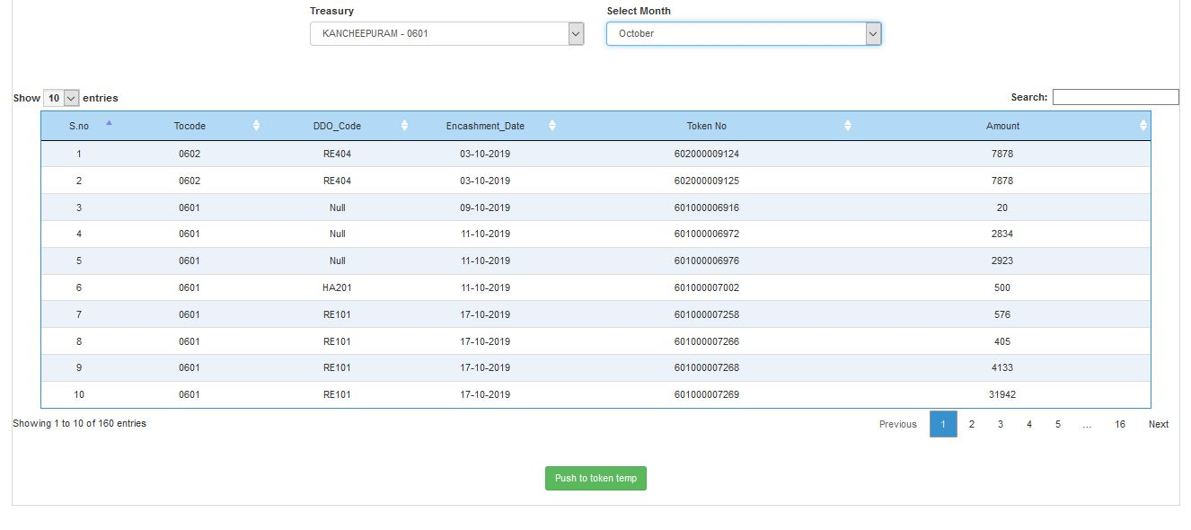
Click the Push to Token temp

Slide 22
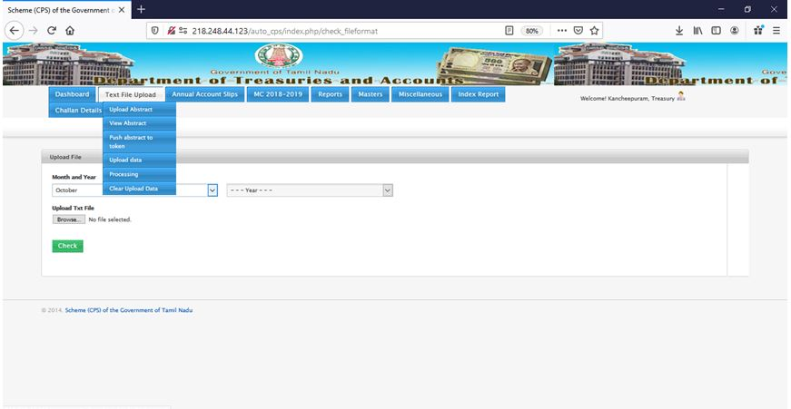
Step3: Upload Data(data available ATBPS Application- CPS monthly wise text file ) ,select month and year

Slide 23
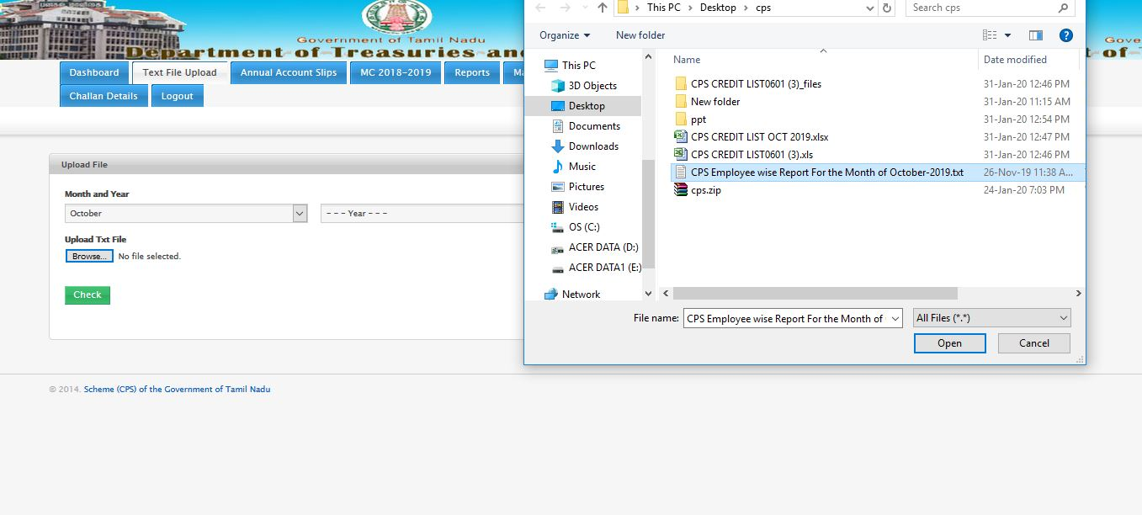
Browse : CPS text file and upload the text file

Slide 24
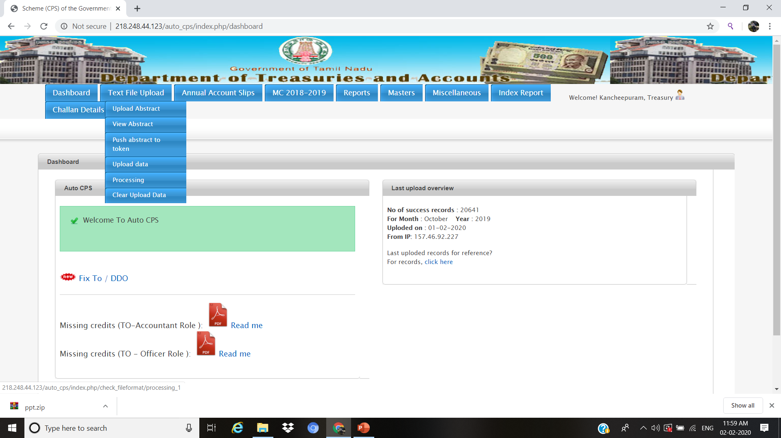
Step4: Processing

Slide 25
THE FOLLOWING ITEMS WILL BE DISCUSSED IN THE ‘STEP 4 – PROCESSING’
1.Upload Error- we can change the incorrect/Wrongly booked CPS number.
2.Name Mismatch- System allows to accept the name of the employee with or without
initials/Surname(Dr.) and it will be updated in the master data.
3.ExcessPayment-Wrongly booked GPF/TPF data has been deleted and change the wrongly booked
Dpcodes.
4.Ref Date- We can update the month/transaction type for the multiple transactions done in a single
month( for example: Multiple transaction means Nov -19,DA arrear, Dec -19 month salary drawn in Dec 2019).

Slide 26
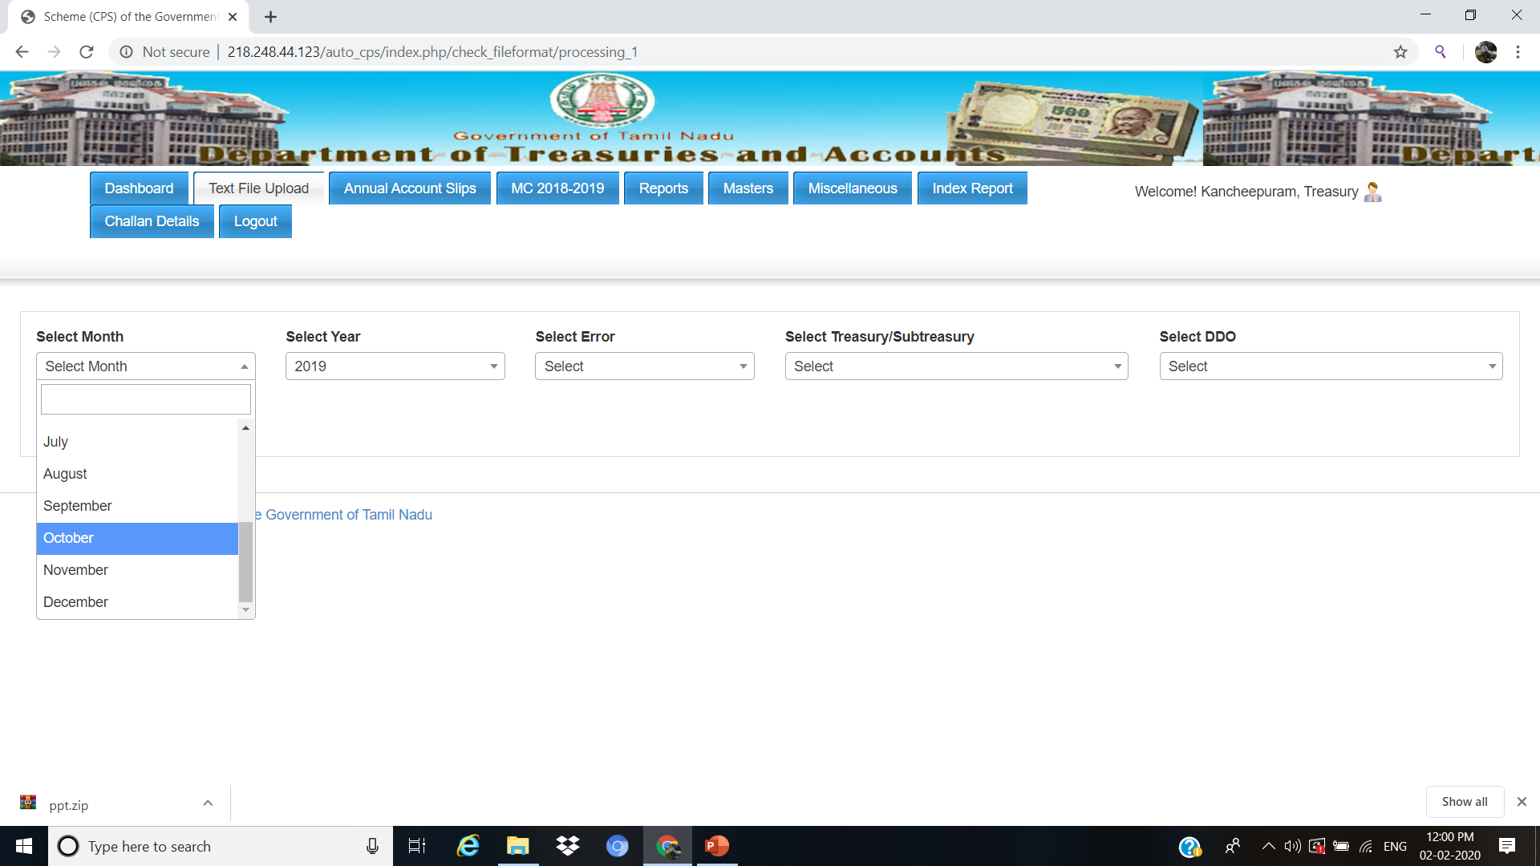
Example: Select month->October ,Year->2019

Slide 27
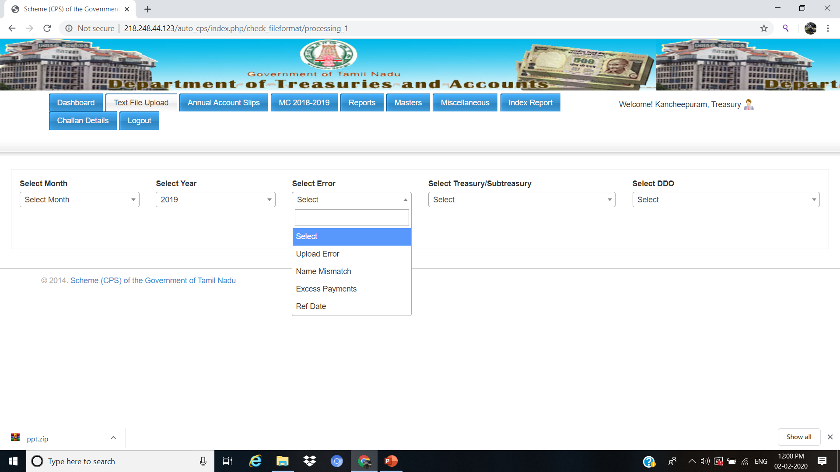
Error types:
1.Upload error
2.Name Mismatch
3.Excess payment
4.Ref Date

Slide 28
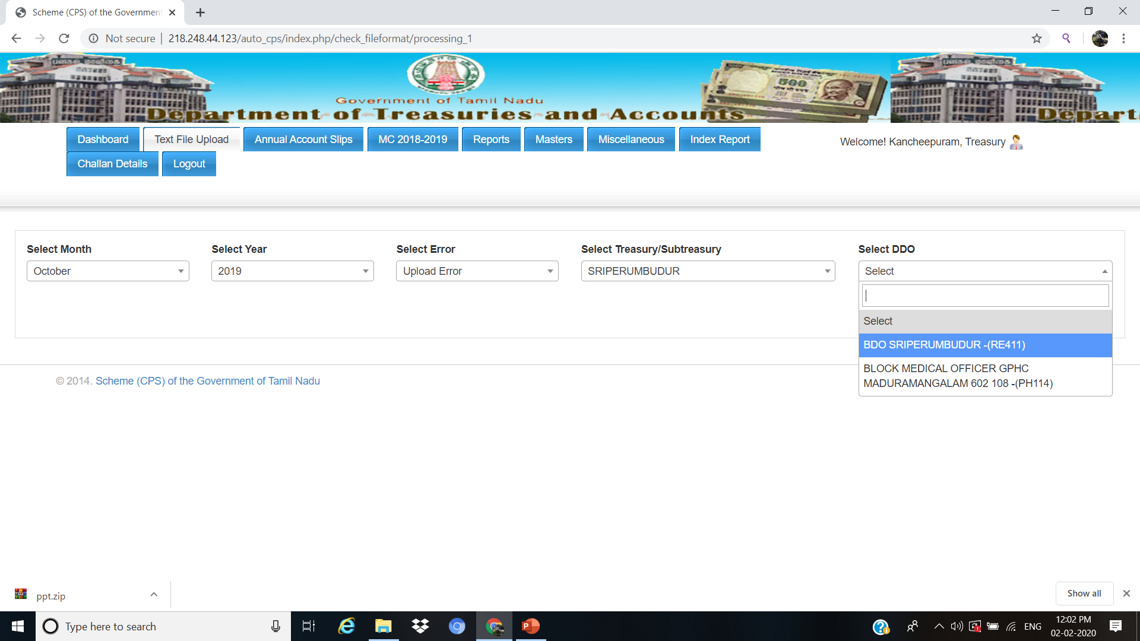
In Upload error
Select –Month ,year ,upload error, Subtreasury , Select the DDO

Slide 29
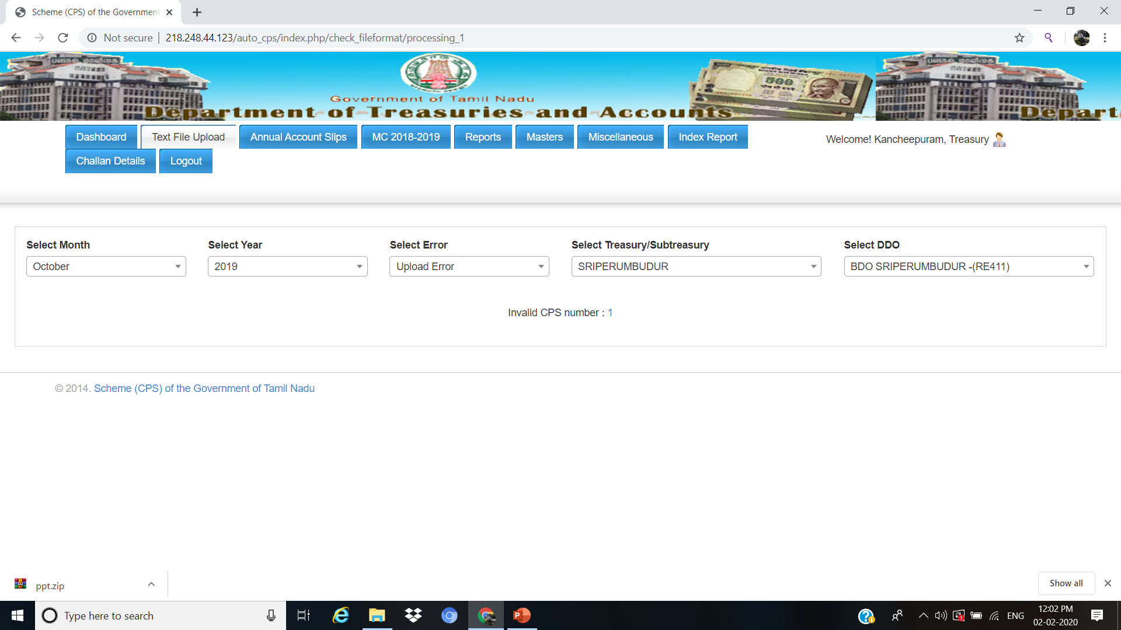
Select the Invalid Cps Number

Slide 30
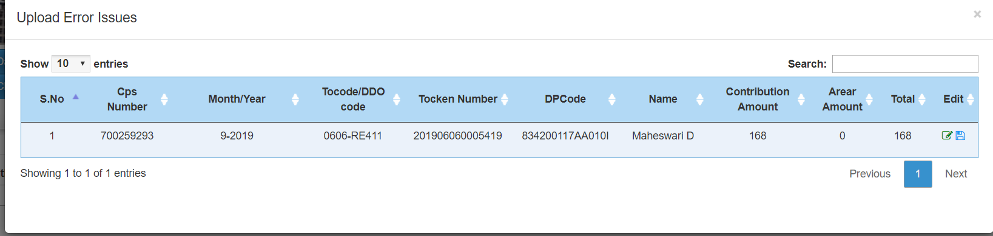
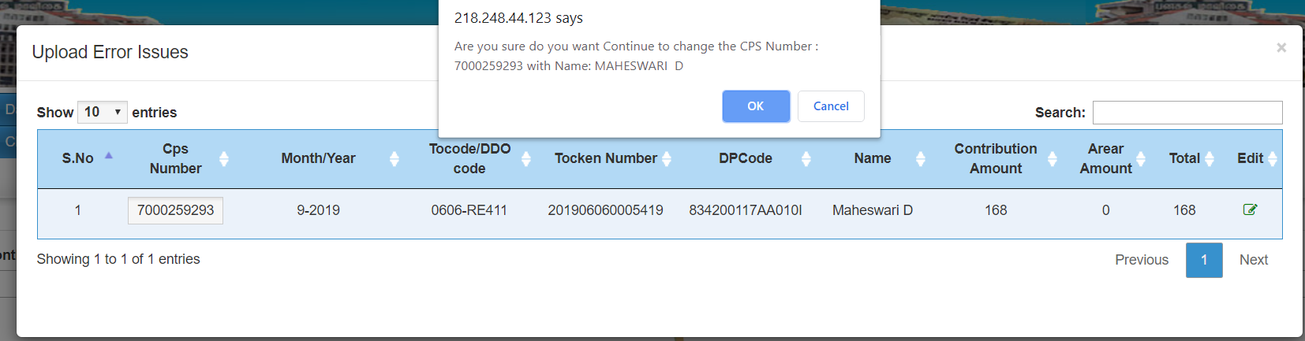
Click Edit,update the Correct CPS number and save

Slide 31
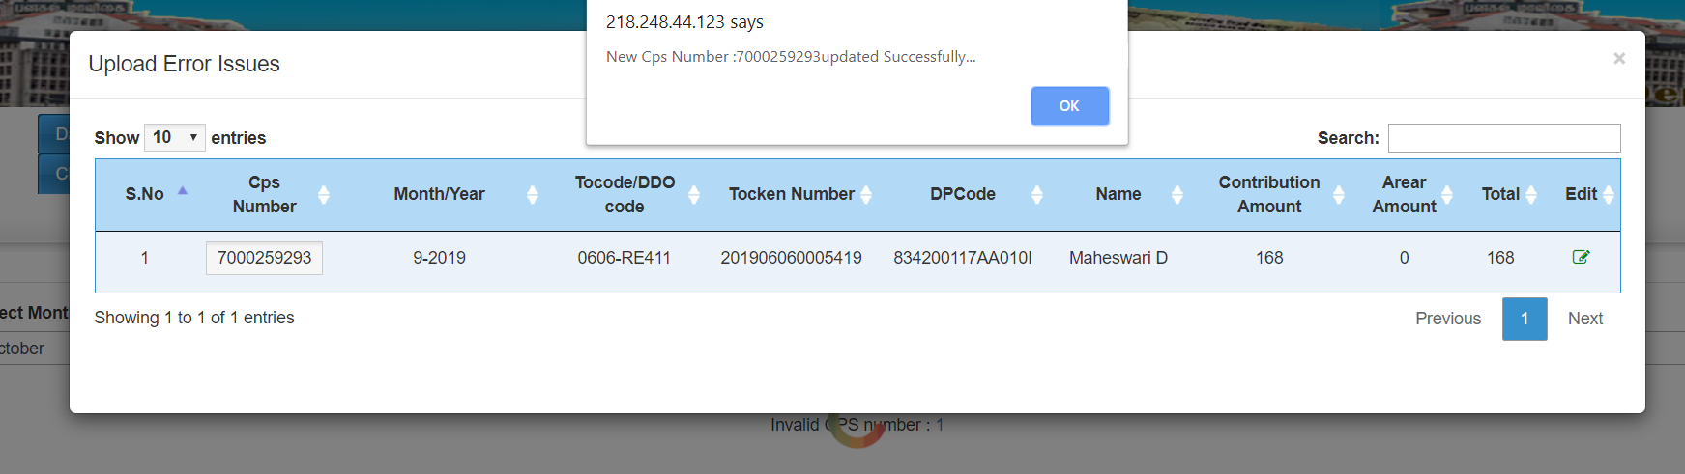

Slide 32
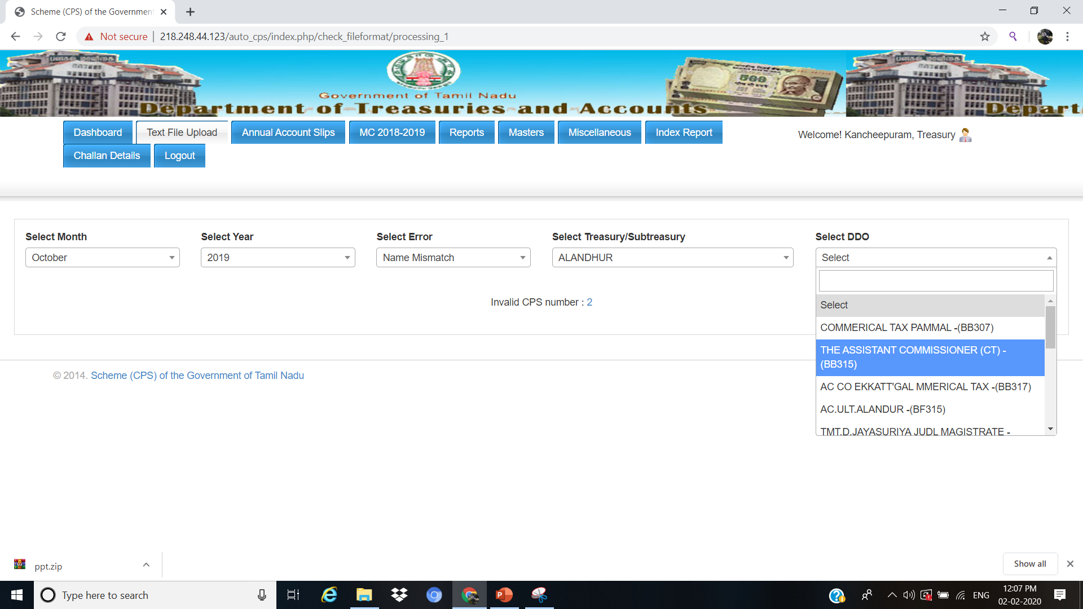
In Name Mismatch
Select –Month ,year ,Name Mismatch, Subtreasury , Select the DDO

Slide 33
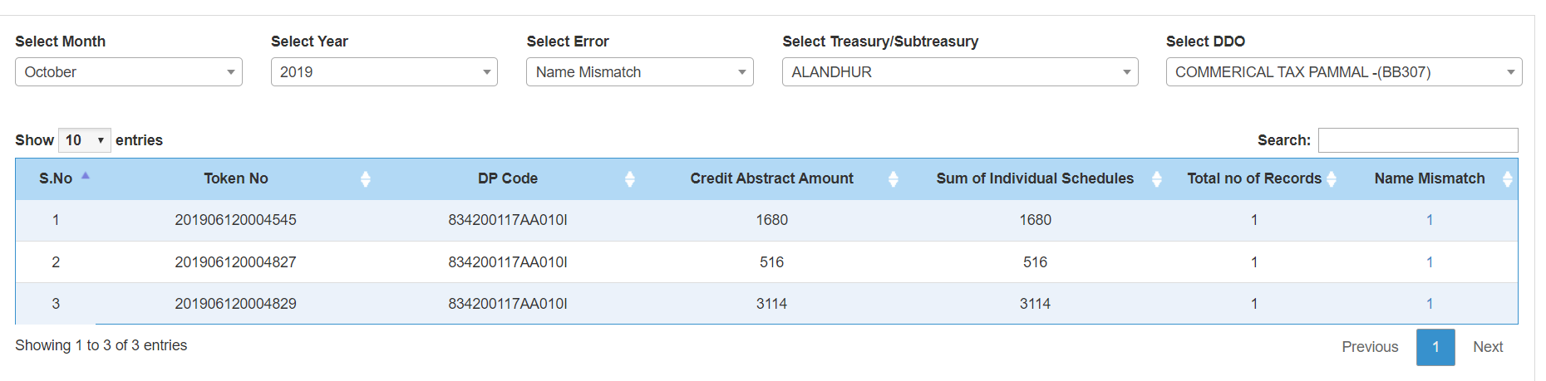
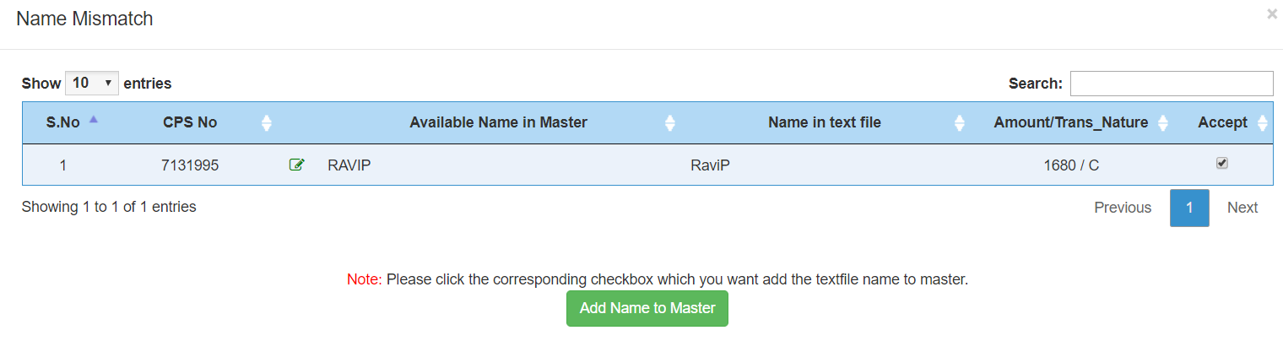
Click the name mismatch
Record will be shown if it is correct click accept and add name to master,
Other wise edit option also available to change the cps number.

Slide 34
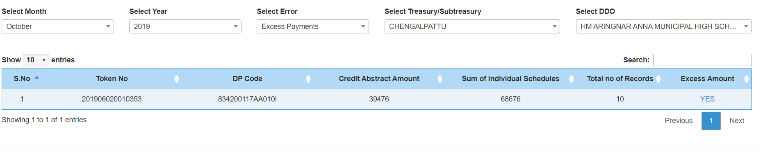
In Excess payments
Select –Month ,year ,Excess payments, Subtreasury , Select the DDO
Click YES and data will be shown

Slide 35
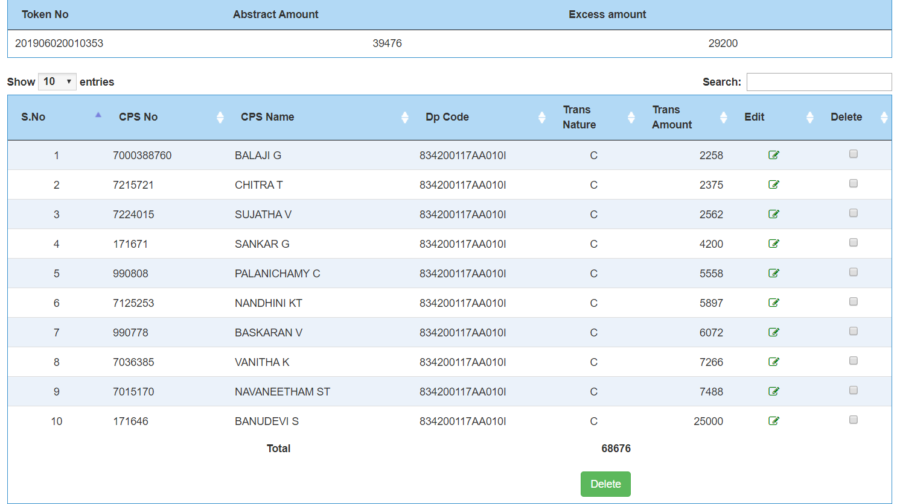
Verify the relevant cps schedule with the record, options are available to edit the Dpcode or delete the record.

Slide 36
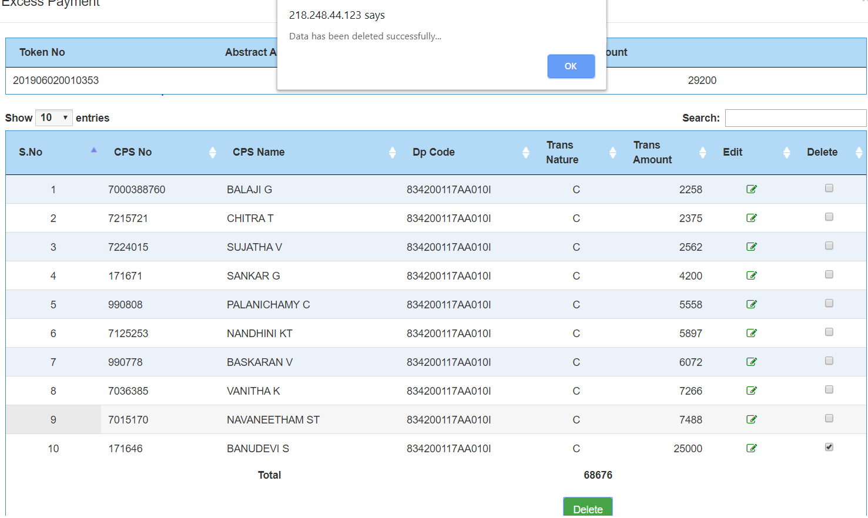
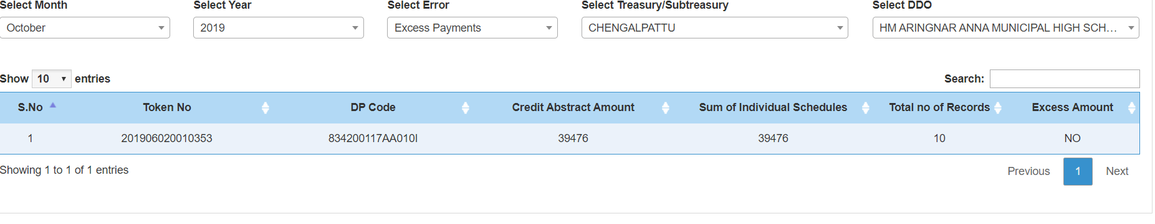
After the deletion of wrongly booked data it shows no excess amount

Slide 37
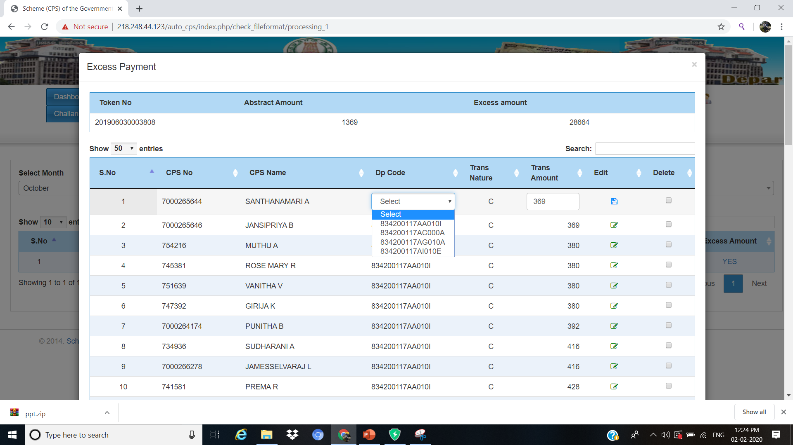
Option available to change the correct DPCODE

Slide 38
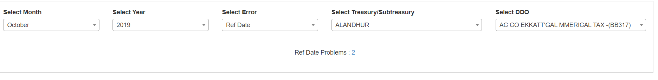
In Ref Date
Select –Month ,year ,Ref Date, Subtreasury , Select the DDO
Click the Ref Date Problem , data will be shown

Slide 39
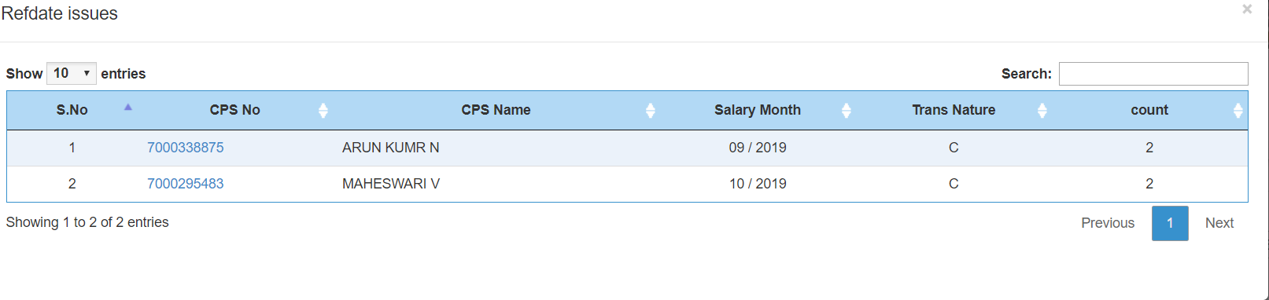
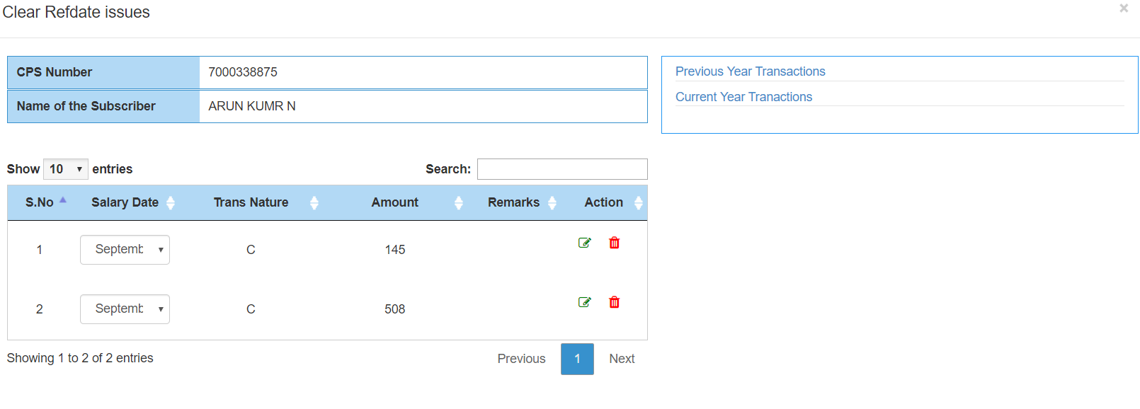
Click the cps Number and Data shown below

Slide 40
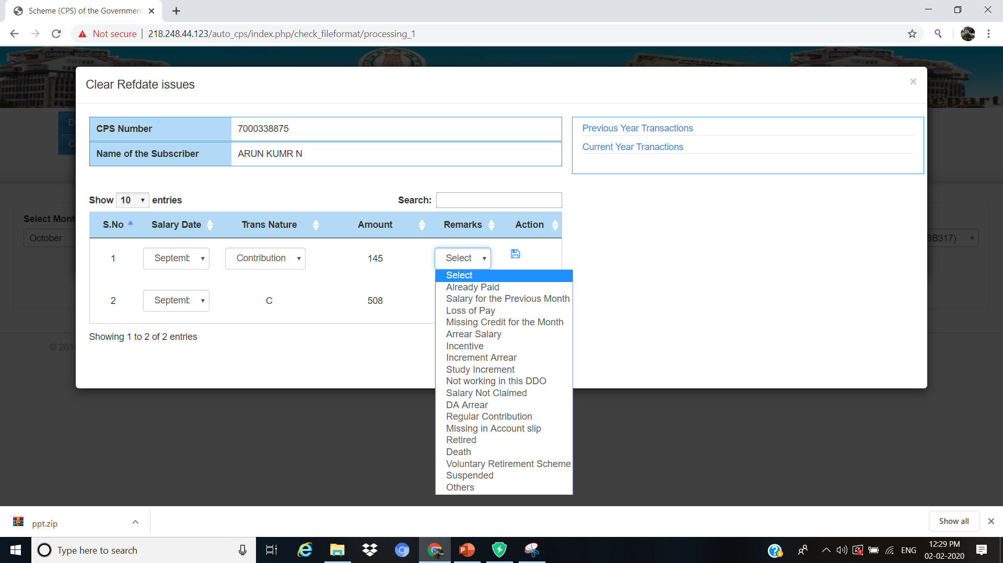
Click Edit ,Change the Transaction nature(Contribution/Arrear/Others) , Select the Relevant Remarks and Save

Slide 41
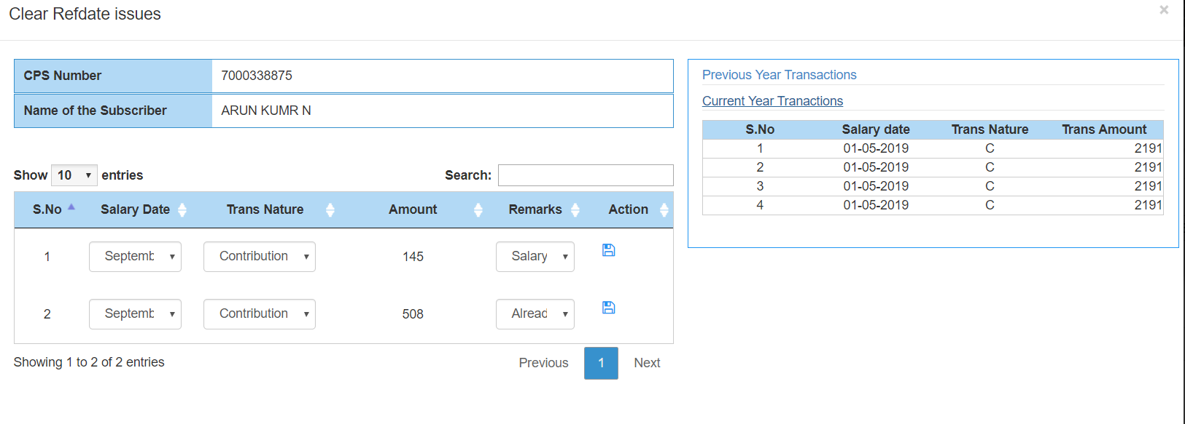
Provision available to view the Previous/Current Year Transaction

Slide 42
Online CPS challan Generation
Online CPS challan Generation in DDO Level and Treasury Level booking and matching the Records will be shown as follows:

Slide 43
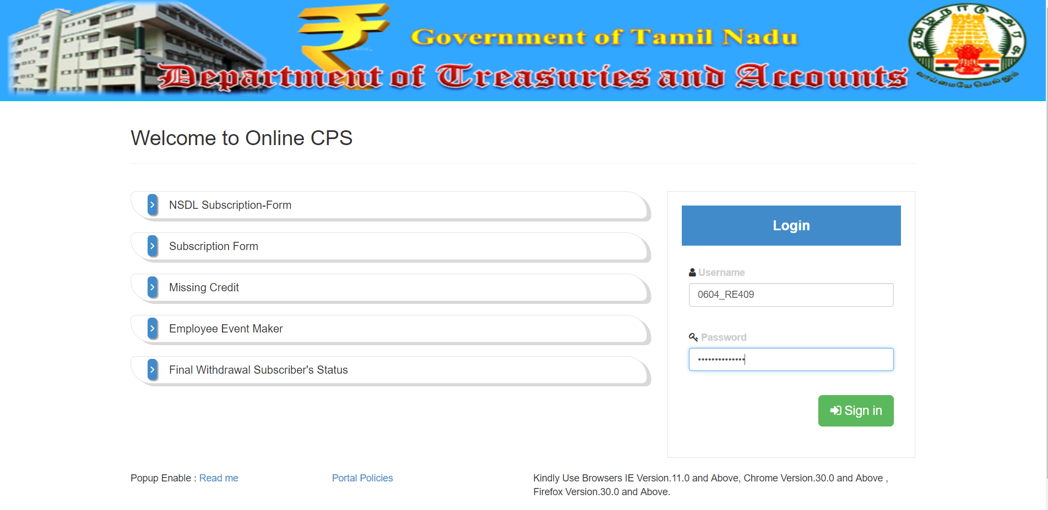
Public Link For DDO Login- http://cps.tn.gov.in
UserName: TOCODE_DDOCODE (0604_RE409)
Password: TOCODE_DDOCODE_123 (0604_RE409_123)

Slide 44
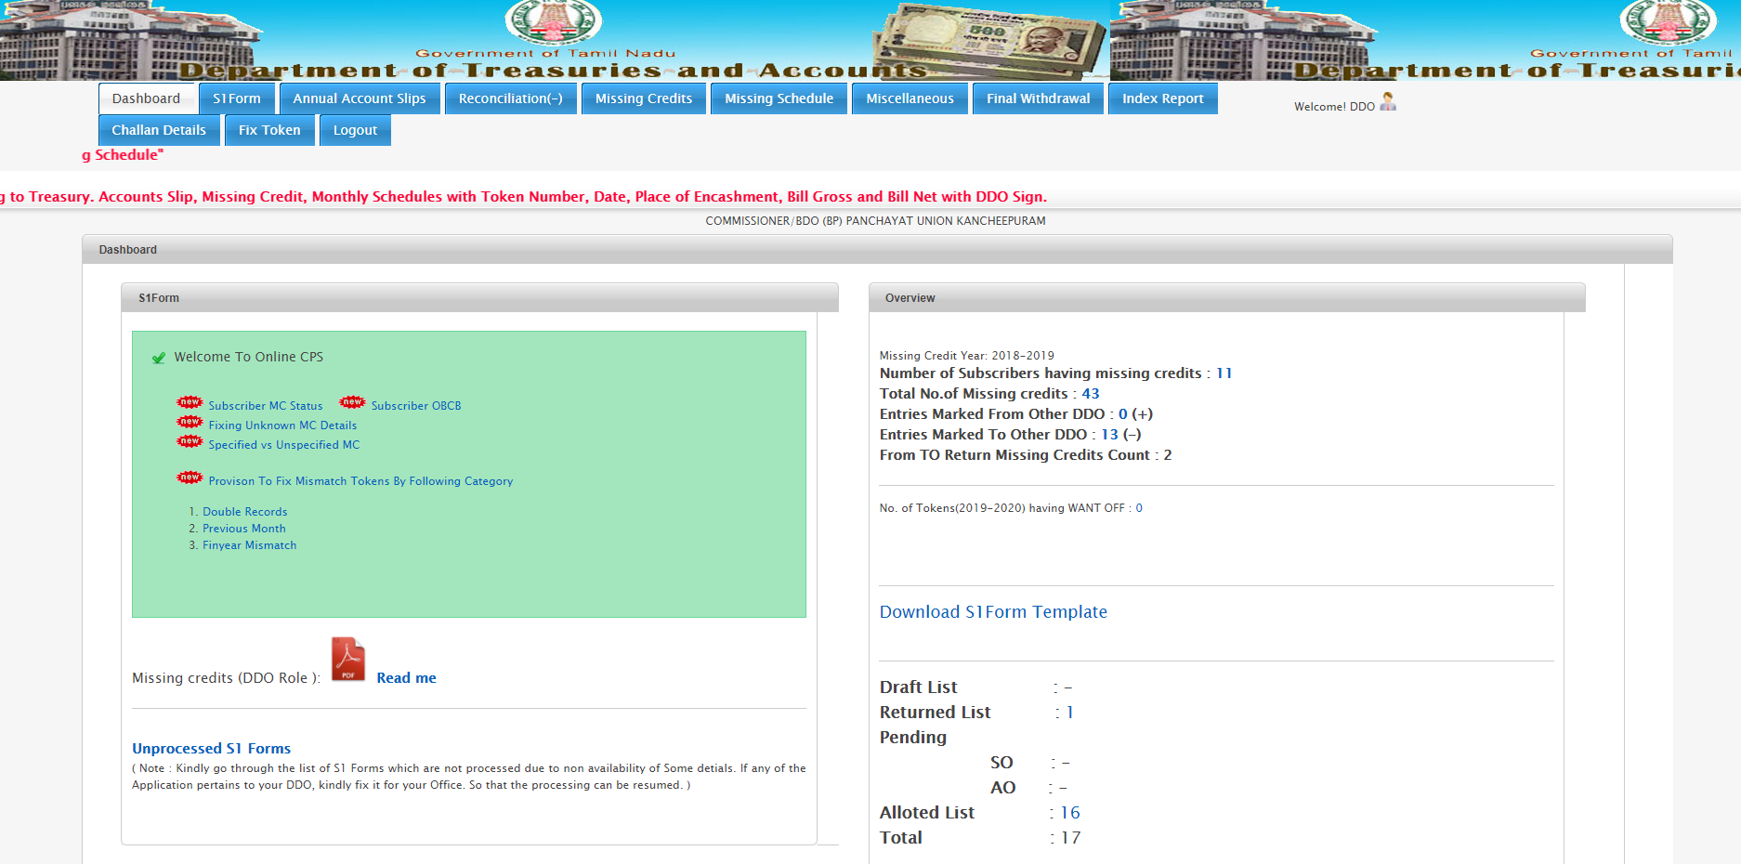
Select challan details it contains summary entry and breakup entry

Slide 45
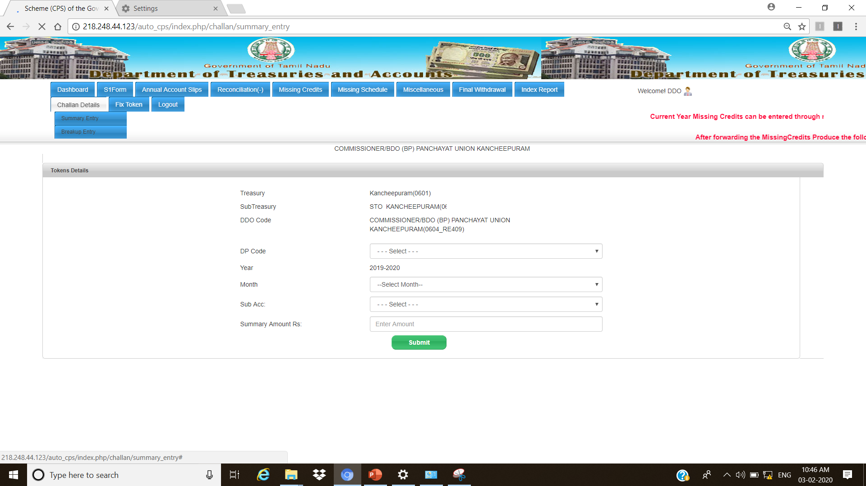
In Summary Entry
Select the dpcode ,month ,
Sub-acct ,Enter the challan amount and give submit

Slide 46
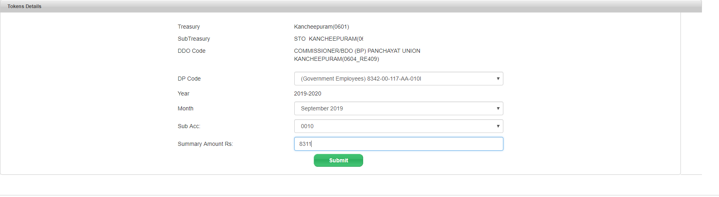
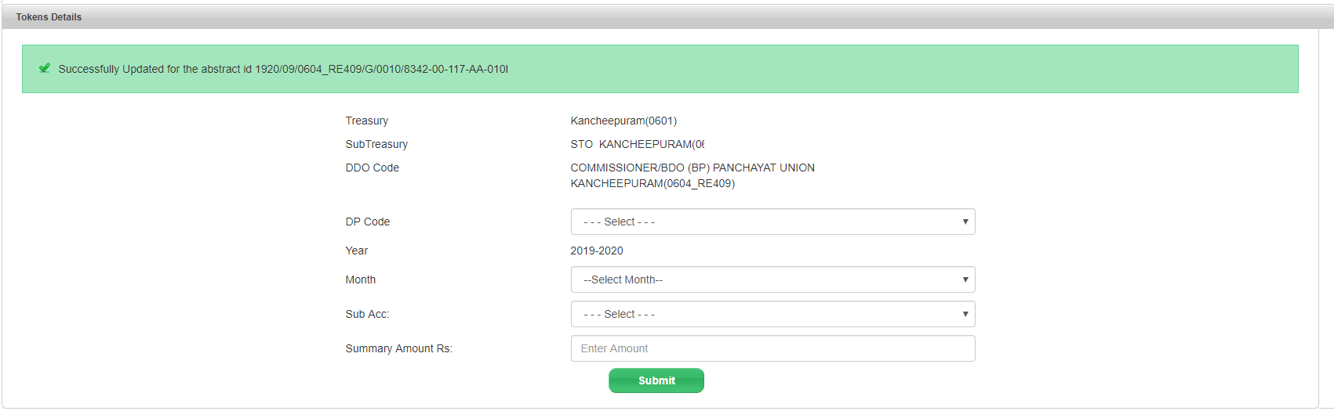
After giving submission in Summary entry ,An Abstract ID will be generated.

Slide 47
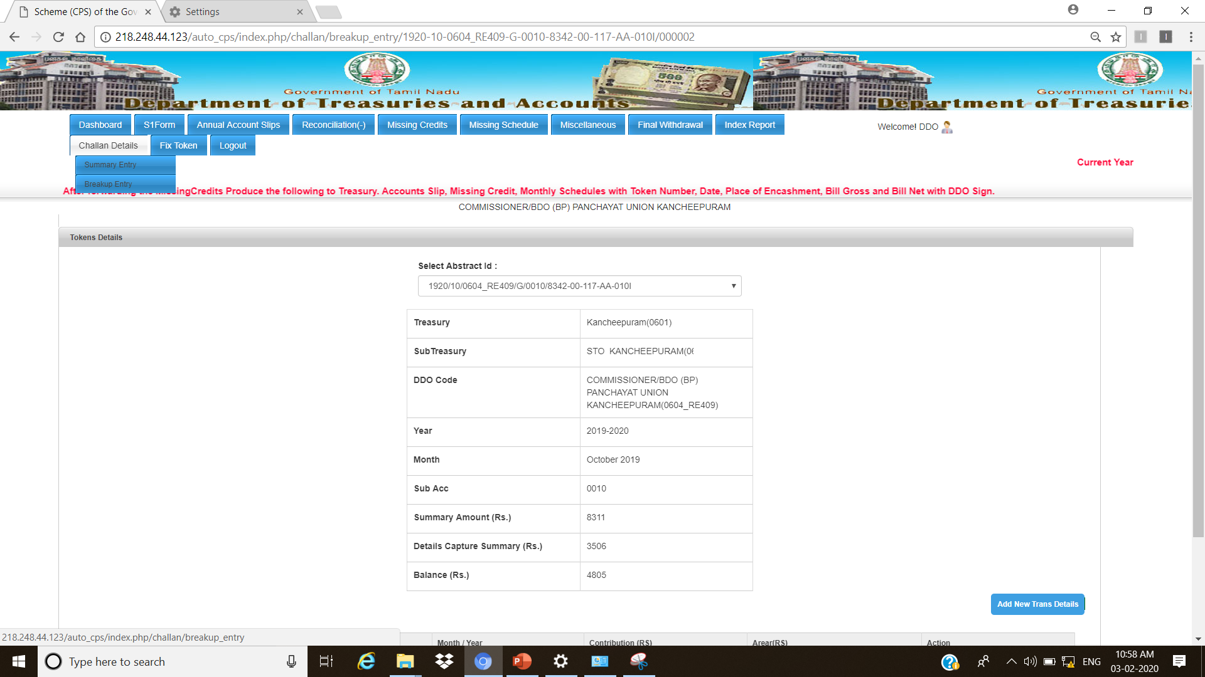
In BreakUp Entry,
Select the Abstract ID and Summary Entry Details Automatically shown.
Now Click the Add New Transaction for the Entering the Breakup Details of challan

Slide 48
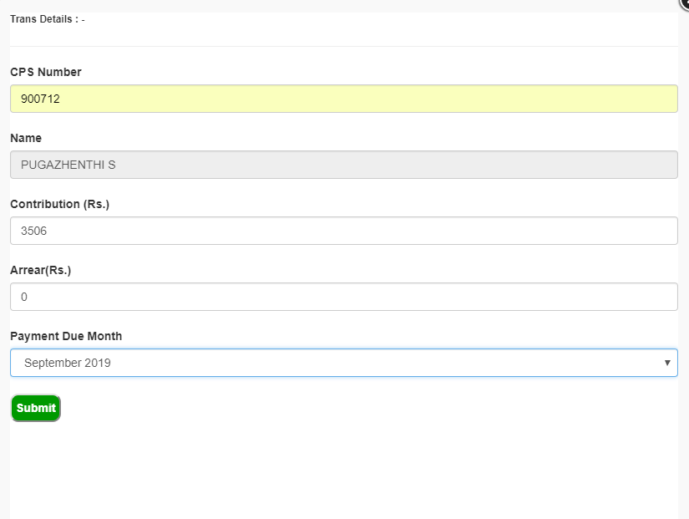
Enter the cps Number name will be automatically shown, now enter the contribution amount, arrear amount, Payment due month and give submit

Slide 49
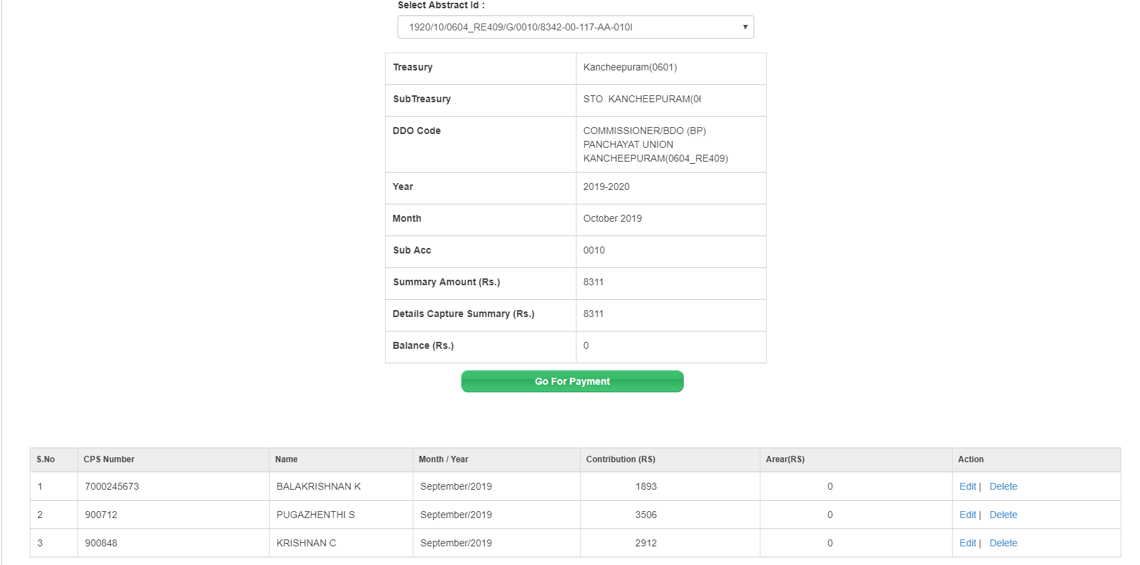
After the entry of challan details, Click Go For payment and Online Challan Form will be generated for making Payment

Slide 50
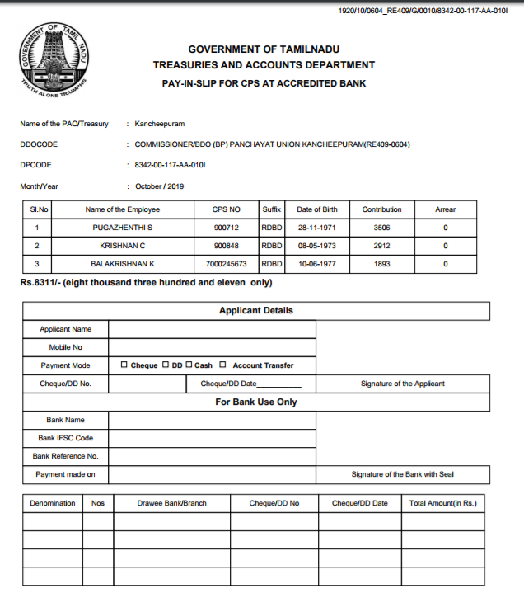
Model online CPS Challan Form

Slide 51

In Treasury Level Booking and matching Record Process
Go to Treasury Admin Login –> Challan Details -> Select Abstract Id->Enter the challan no./Date (Which is allotted in ATBPS account) –Select the Bank/Branch and then submit . Record Will be transferred to Treasury Accountant Login.

Slide 52


Slide 53

Treasury Accountant Login
Select Missing Schedule -> click challan entry –select challan no->verify the records and forward to officer login.

Slide 54

Treasury Officer Login
Select Missing Schedule -> click challan entry –select challan no->verify the records and forward /Return to Acct.

